Slide 1

Find a friend. Date a friend. Why strangers?

Slide 2

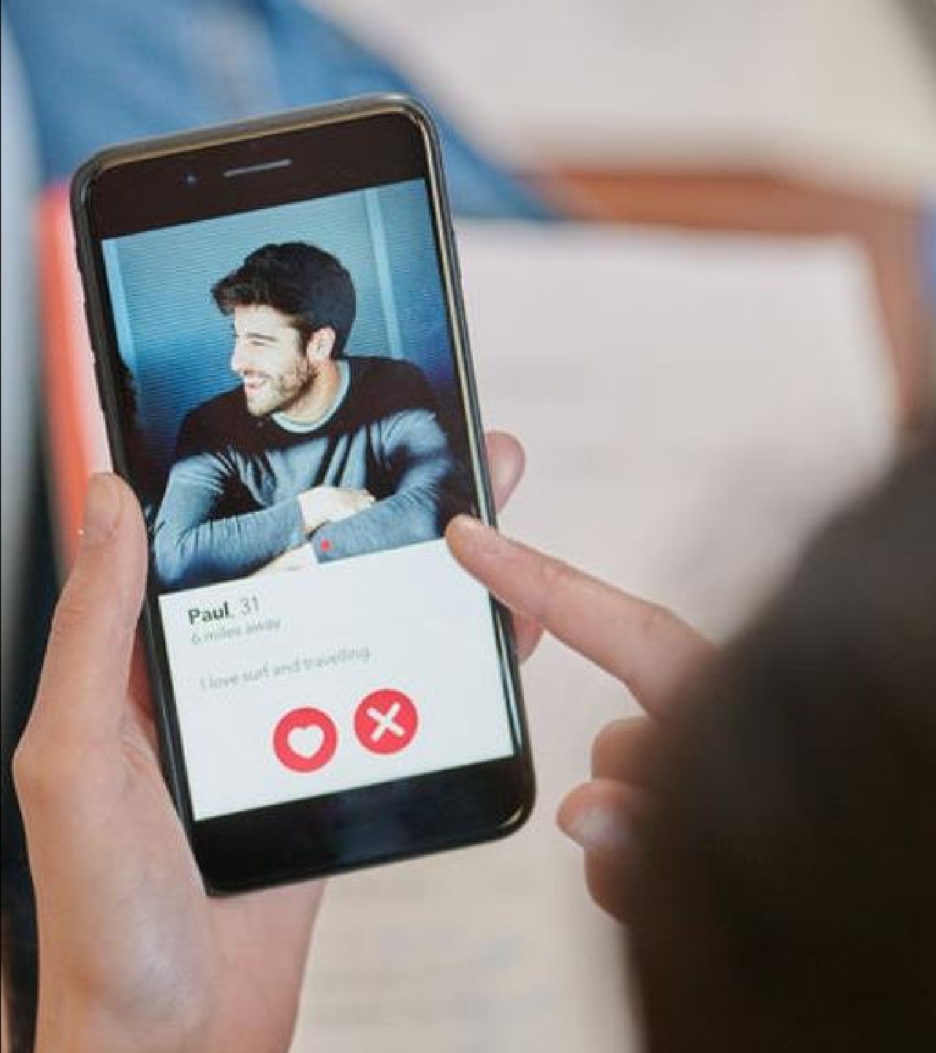
Introducing
The First
Socio-Dating App
BeYu is the first one of its kind , a socio-dating app that provides matches with friends or with mutual friends only therefore no matching with strangers anymore with a proper authenticity of data and one can see the profile before sending a match and networking socially at the same time thus making more friends.

Slide 3


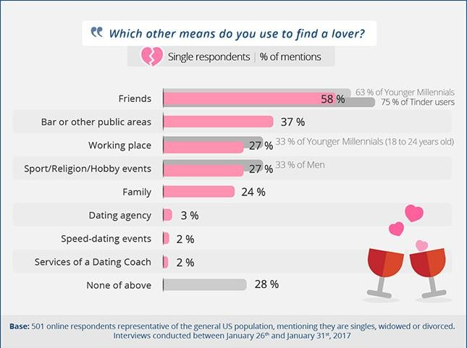
What is the Problem?
Is there any platform that enables match making within the peer or mutual friend circle?
- Users usually land up on online dating apps to look for a meaningful relationships and to expand their social circles. But are the existing dating platforms the right place to build this socio circle?
- Existing Application or platforms provide match making only with strangers. What if one wants a match within his/her social circle!?
Friends (58%) + Family (24%) = 82% Need BeYu

Slide 4
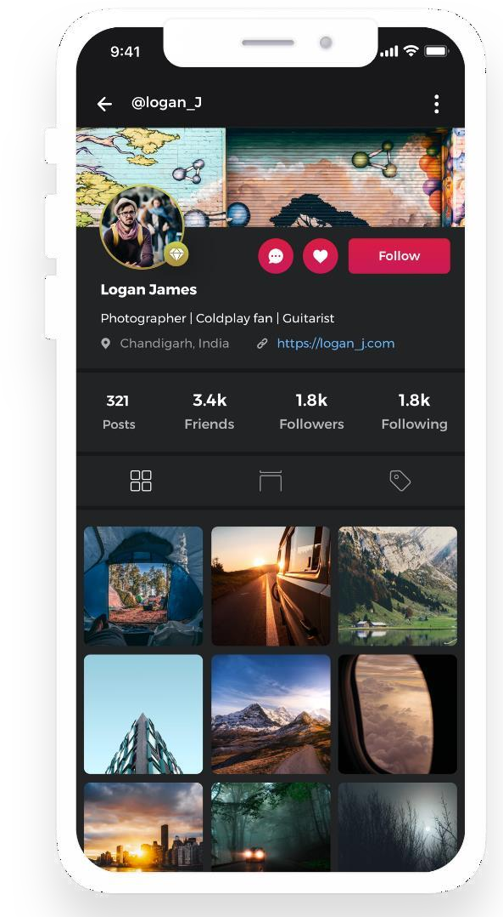
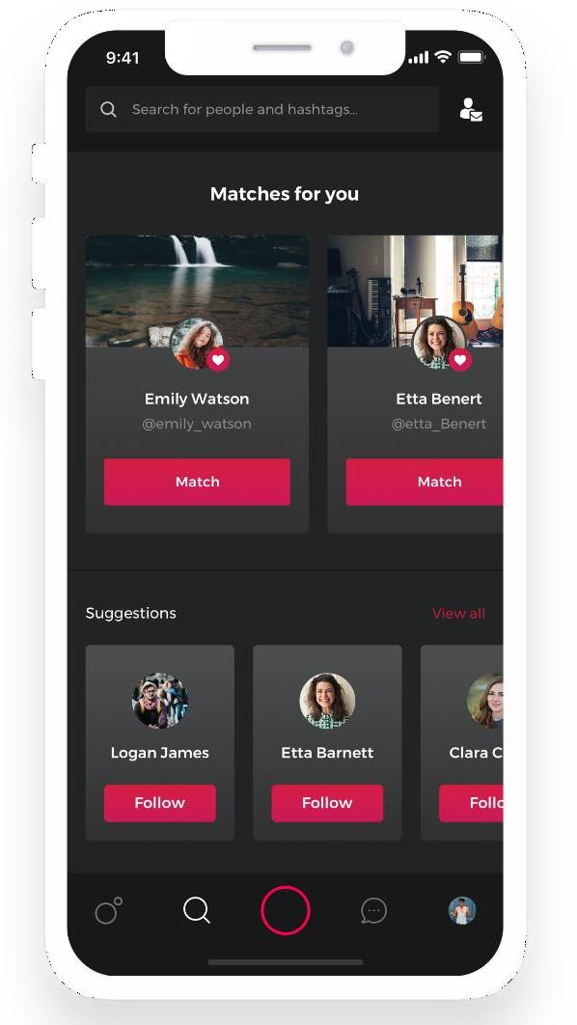
Our Concept
Key Features
Users can connect with their
friends or make new friends.
Let users to match with known people or the people they like.
Get matches from friends
Of friends or Searchfor the people you like and send a match, if they like you as well then get connected.
Users can chat with anyone.
Allows users to chat anonymously.
One can capture and share photos and videos with friends or with the people they like.

Slide 5

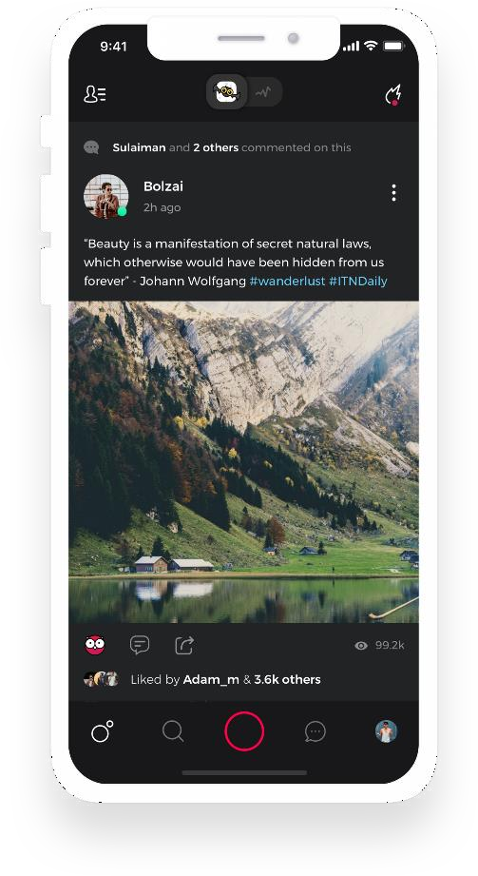
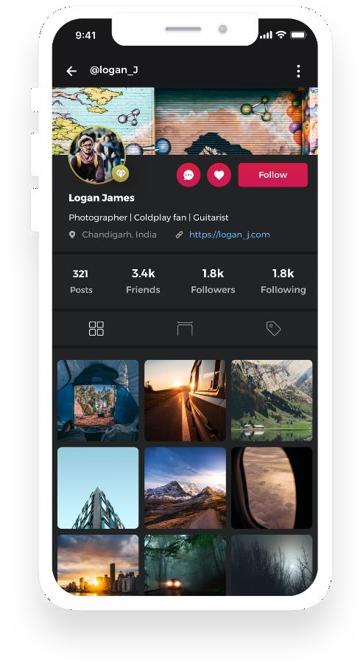
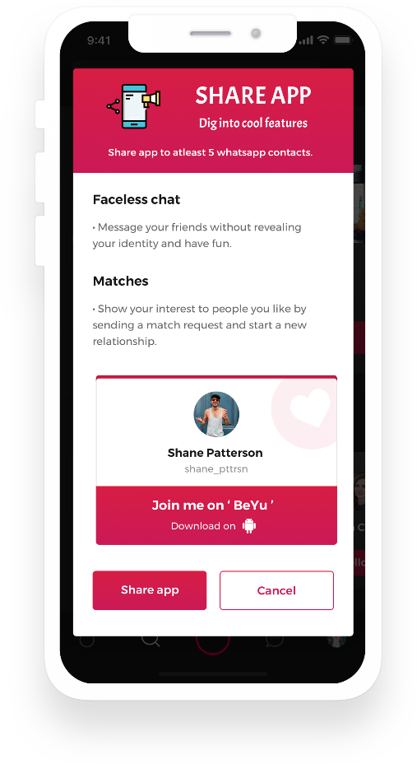
Our Product : How does it work?
Share and see posts on your timeline from friends and matches
Follow your friends and matches.
Digital Card for your identity

Slide 6

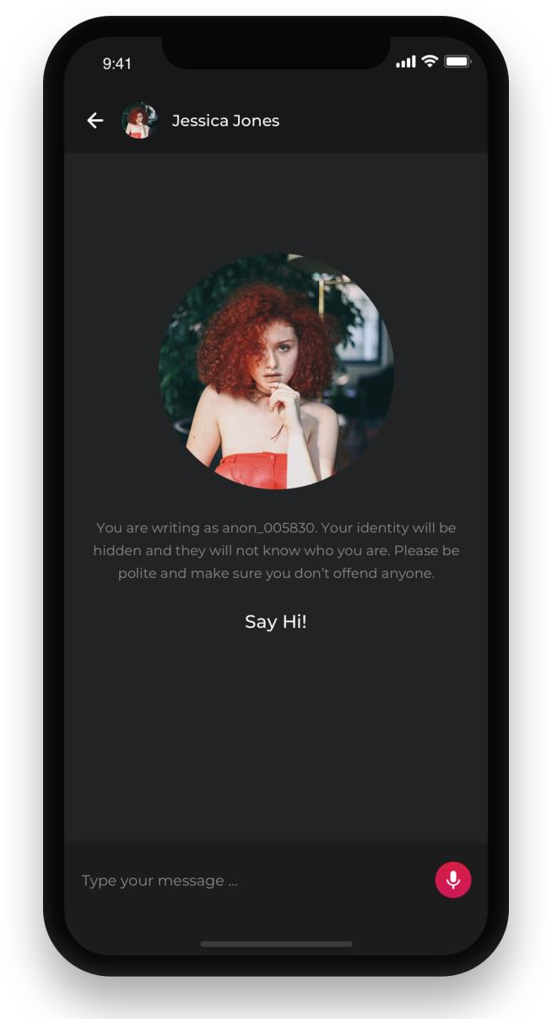
Women’s Safety is Important
Keeping women’s safety , we have a special feature
for our female users!
Fearing harassment, 70% of the female users of dating application are also comprehensive about sharing their personal information, Woo’s survey has found.
Introducing
Faceless Match & Faceless Chat for women
Female users can show interest to anyone without revealing your photo, name and bio. Just be anonymous

Slide 7

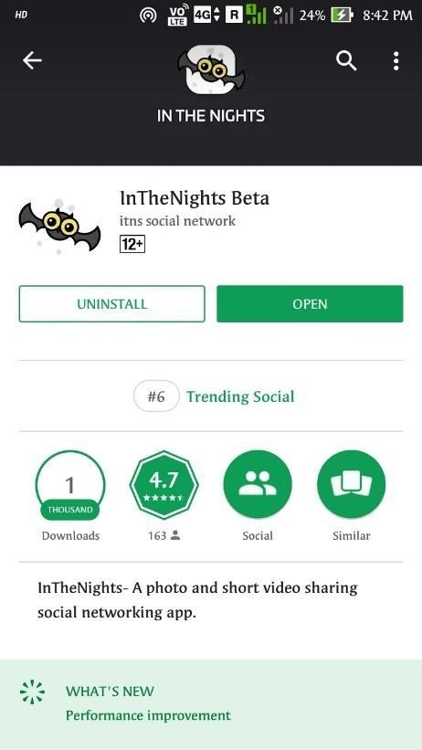
Traction of beta version
9500+ downloads inAndroid
700 Downloads in itunes
We were on trending on both playstore and Appstore and yet did not find product market fit.
8500 Total Registered Users
3.7k Monthly ActiveUsers
Hits from more than 7
Countries with just beta version
500 active users per day
Beta Version, User Engagement was 12 Minutes 21 seconds.
We have currently disabled our product on playstore and Appstore to work more on the users feedback to launch a new app i.e BeYu.

Slide 8

Market Opportunity
TAM
$12 billion
Global online dating services market to grow at a
CAGR of 5.31%
SAM
$310 million
G o - T o - M a r k e t
SOM
$155 Million
Bringing Influencers
Highly viral product
College Campaigning and running viral campaigns.
Product Hunt, Hacker News, Flipboard, TechCrunch
Bloggers and youtubers, SEO and ASO
Inbuilt Sharing to other networks
Social Networking is $55 Billion industry (2019)

Slide 9
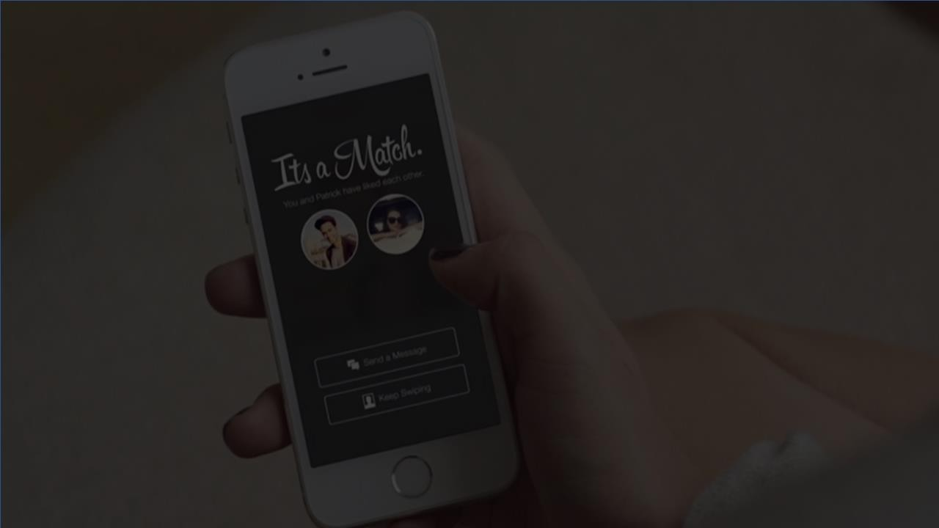

Business Model
Who viewed your profile.
Unlimited faceless chats.
Unlimited matches.
Earn a badge and look special.
BeYu identity card.
+
6
Months
INR 649/-
1
Month
INR 249/-
3
Months
INR 449/-
12
Months
INR 1049/-

Slide 10
















Competitive Analysis
Competitors
Connecting with friends
Matching with strangers
Sharing photos & videos with friends
Messaging with friends
Anonymous chat
Pricing | INR 500+ | INR 500+ | INR 500+ | INR 149 | INR 249

Slide 11
The Ask
$250K
For
14 Months
10%
R&D
30%
Technical Operations and HR
30%
Product launch and marketing.
30%
History
Investment raised so far: $60K (Founder, Relatives and Angel investors)
Current burn rate: INR 1.5 Lakhs per month
G&A

Slide 12
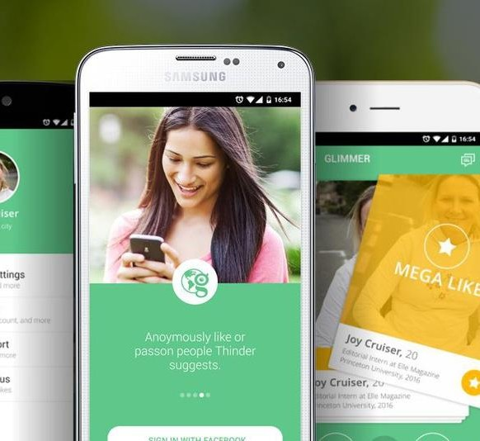
User Growth
120 Mn
100 Mn
80 Mn
60 Mn
40 Mn
20 Mn
0
s r
Use of
.
No
Financial Projections Next 4 Years
2019
2020
2021
2022
2023
Year
Substantial Financial Growth
3,00,00,000
2,50,00,000
2,00,00,000
1,50,00,000
1,00,00,000
50,00,000
0
Revenue in $
2019
2020
2021
Year
2022
2023

Slide 13
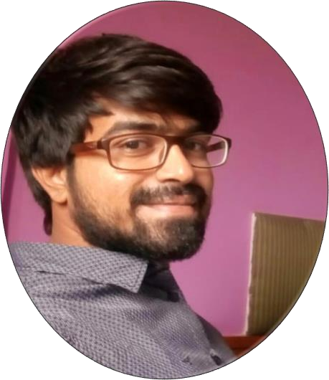
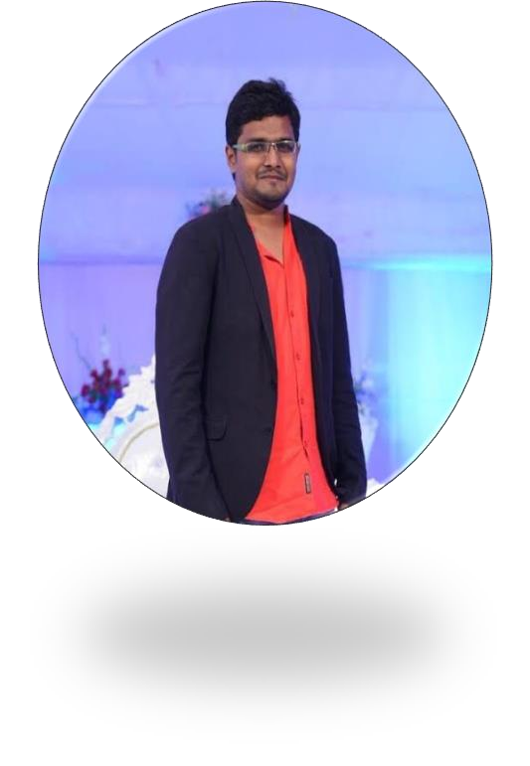
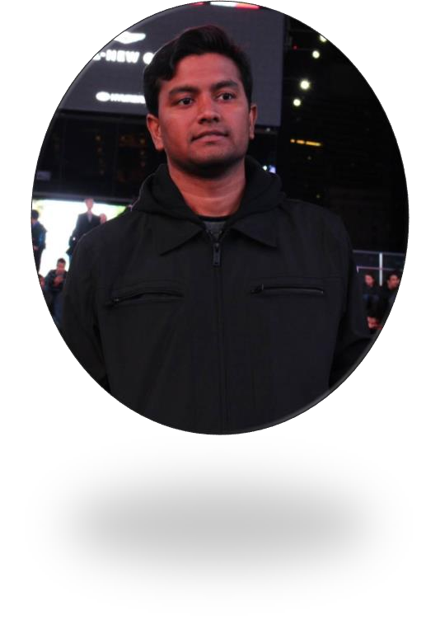
The Team Behind
Desai Ram Mohan Co-founder ( CPO )
B.E (electronics) from BITM and
Passionate Programmer.
Mudassir Ahamed Co-founder (CTO)
Software Engineer,
12 years+ experience in IT. MCA (Osmania University) Ex: Accenture (USA)
Sulaiman mmd
Co-founder (CEO / CMO)
Promoter of camerapays and the sheep . B.com (Computers) from sri Krishna devaraya university.

Slide 14
Thank You

